Slide 1

IT University of Copenhagen
Program Name: Bachelor of Science (BSc) in Data Science.
University: IT University of Copenhagen (ITU), Denmark.

Slide 2

Bachelor of Science in Data Science
Duration of Study: 3 years (6 semesters).
Language of Instruction: English.

Slide 3

1st and 2nd Semester
1st Semester: Introduction to Data Science and Programming; Linear Algebra and Optimisation; Foundations of Probability.
2nd Semester: Applied Statistics; Algorithms and Data Structures; Projects in Data Science.

Slide 4

3rd and 4th Semester
3rd Semester: Machine Learning; Introduction to Database; Systems Network Analysis.
4th Semester: Natural Language Processing and Deep Learning; Data Visualization and Data-driven Decision-making; Large-Scale Data Analysis.

Slide 5
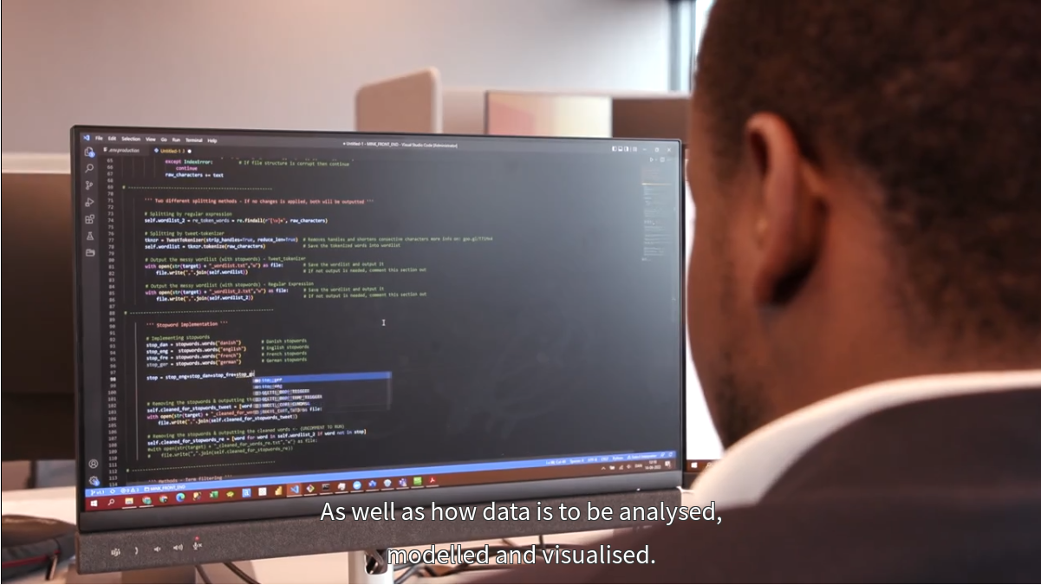
5th and 6th Semester
5th Semester: Technical Communication; Security and Privacy; Software Development and Software Engineering; Elective.
6th Semester: Bachelor Project; Reflections on Data Science; Elective.

Slide 6

Additional Information
Tuition Fee: DKK 50,000 per semester (as of January 2024)
Housing System: The university provides dormitories and private housing.

Slide 7

Additional Information
The program is taught in English.
The program uses case studies from both Danish and international organizations.
Students have access to a Study Lab for support with courses and academic topics.
Live Coding sessions are held for first-semester students to enhance programming skills.

Slide 8

Reasons for Participating in the Program
International experience.
Improve your skills
Build social and collaborative skills.
World-class university

Slide 9
Slide title
Slide text

